Slide 1
School Spotlight
Apr.
2019
Bear River Academy

Slide 2
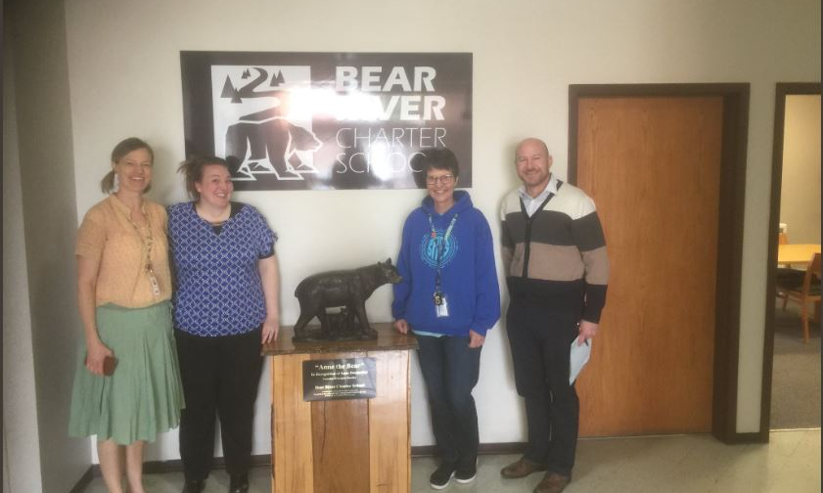
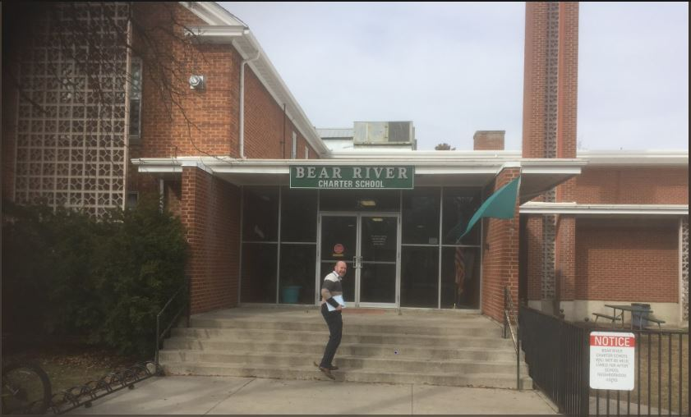
Greatest DIBELS growth from BOY to MOY
9 schools have 75% of students making typical or better progress by MOY
State goal is 60% making typical or better growth by the EOY

Slide 3
SY2019 Percent DIBELS Growth from BOY to MOY

Slide 4
Congratulations, Bear River Academy!

